Slide 1

Final Project Brazil Olist Ecommerce

Slide 2
Agenda
Introduction
Problem Statement and Objectives
Challenges
Python Modules
Methodology and Process Flow
Data Understanding
(ET)L Process using Tableau prep builder Analysis
ET(L) Process using PySpark in Databricks Community on Cloud
Workflows in Databricks Community on Cloud
Data Verification of Data loaded into Azure SQL DB and Queried by Power BI
Artificial intelligence using MLlib (Machine Learning Library) in Databricks Community on Cloud
Business intelligence using Power BI
Conclusion

Slide 3




Introduction

Slide 4
Introduction
Olist is the largest department store in Brazilian ecommerce marketplaces.
Olist connects small businesses from all over Brazil to channels with a single contract.
Those merchants are able to sell their products through the Olist Store and ship them directly to the customers using Olist logistics partners
After a customer purchases the product from Olist Store, a seller gets notified to fulfill that order.
Once the customer receives the product, the customer gets a satisfaction survey by email
The customer can give a note for the purchase experience and write down some comments.
The dataset provided has information of 100k orders from 2016 to 2018 made at multiple marketplaces in Brazil.
It contain features of different orders from order status, price, payment and freight performance to customer location, product attributes, customer comments and scoring.

Slide 5
Problem Statement and Objectives

Slide 6
Objectives
Problem statement
Olist receives diverse customer reviews across its wide range of products and services.
Olist wants to better understand the customer satisfaction and identify opportunities for improving service quality and product offerings, thus there is a need for Olist to systematically analyze these review scores with associated customer comments and sentiments pertaining to products, product categories, and geographic distributions to uncover patterns and insights.
Analyze and understand the statistics and weightage of review scores provided by customers
Analyze and understand the sentiments of customers on the received products and Olist services
Analyze and understand the statistics and weightage of review scores based on different product name category
Analyze and understand the distribution coverage of review scores in terms of geolocation

Slide 7
Challenges

Slide 8
Challenges - Member-level
Difficulty
Steep Learning Curve for New Technologies
Normalizing Complex Text Fields with Unusual and Funny Characters
Diagnose issues during Tableau Prep flows, PySpark job runs, SQL ingestion due to complex error messages
Overcome
Intensive research, stay focused and knowledge sharing
Use Tableau Prep Builder and PySpark’s Unicode normalization for cleaning, and create reusable cleaning scripts and processes
Intensive investigation and research, break down into smaller segments, narrow down and test Incrementally

Slide 9
Python Modules

Slide 10
Python Modules
These Python modules are required for the Final Project
 | Python Module | Usage
(1) | numpy | For working with arrays
(2) | pandas | For working with data sets
(3) | matplotlib | For plotting charts for data visualization
(4) | seaborn | For plotting advanced charts for data visualization
(5) | Tabpy | For running python scripts in Tableau Prep Builder
(6) | pyspark | For running pyspark codes for dataframe manipulation, connecting to Azure SQL DB and machine learning modelling
(7) | unicodedata | For accessing to the Unicode Character Database (UCD) which defines character properties for all Unicode characters
(8) | re | For running regular expression
(9) | wordcloud | For presenting visual representation of text data for sentiment analysis

Slide 11
methodology and Process Flow

Slide 12
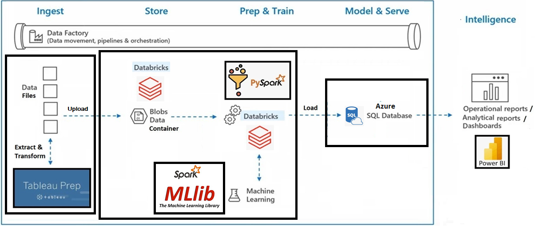
methodology and Process Flow
Extract - Data (csv files) are collected and uploaded to blobs data container in Databricks Community on Cloud.
Transform - The data are cleaned, formatted, transformed and validated using Tableau Prep Builder.
Load - The processed data is loaded to blobs data container in Databricks Community on Cloud and stored in a target system (Azure SQL Database) via PySpark in Databricks.
Intelligence Analysis – AI machine learning and modelling are done thru MLlib in PySpark and BI analysis are done by using PowerBI.

Slide 13
Data Understanding

Slide 14
Data source Files (Kaggle website)
Data File | Data description
olist_customers_dataset.csv | This dataset has information about the customer and its location. It identifies unique customers in the orders dataset and to find the orders delivery location.
olist_geolocation_dataset.csv | This dataset has information Brazilian zip codes and its latitude/longitude coordinates.
olist_order_items_dataset.csv | This dataset includes data about the items purchased within each order.
olist_order_payments_dataset.csv | This dataset includes data about the orders payment options.
olist_order_reviews_dataset.csv | This dataset includes data about the reviews made by the customers.
olist_orders_dataset.csv | This is the core dataset that contains orders information.
olist_products_dataset.csv | This dataset includes data about the products sold by Olist.
olist_sellers_dataset.csv | This dataset includes data about the sellers that fulfilled orders made at Olist.
product_category_name_translation.csv | This dataset translates the product_category_name to english.

Slide 15
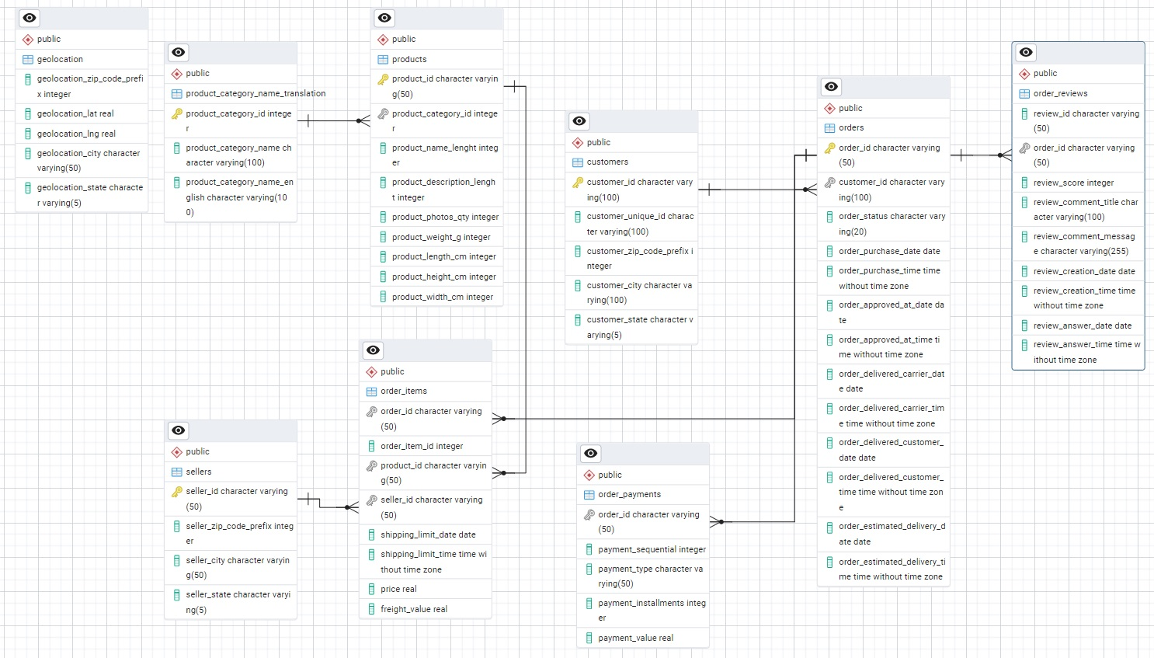
Entity Relationship Diagram

Slide 16
(ET)L Process using Tableau prep builder

Slide 17
(ET)L using tableau prep builder
Tableau Prep Builder provides clear and instant panorama view and strong facility for extraction, transformation and cleaning of the data in this project :
(1) Remove whitespace, or funny, unusual and unwanted characters.
(2) Replace null datetime fields with nominal datetime value (‘01/01/1999 01:00:00’)
(3) Split or trim fields - Split datetime fields into date field and time field.

Slide 18
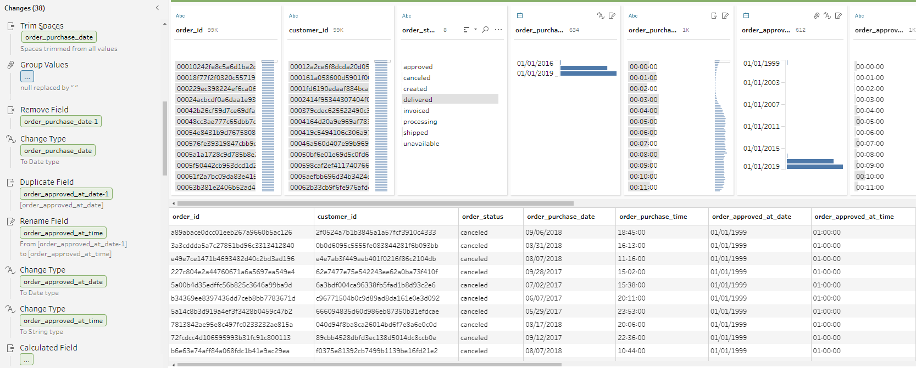
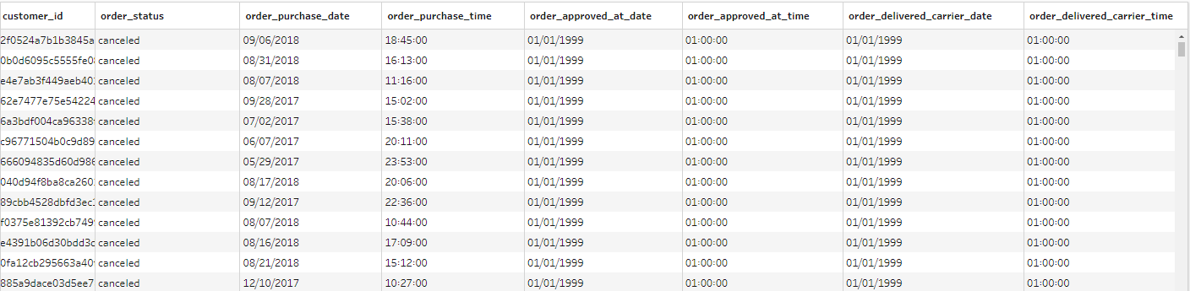
(ET)L using tableau prep builder
Extraction and Transformation
Output

Slide 19
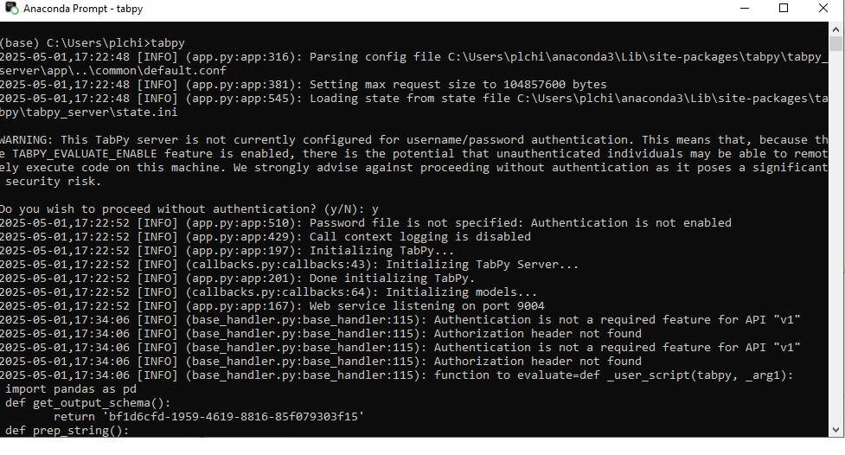
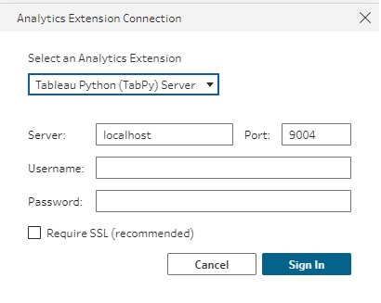
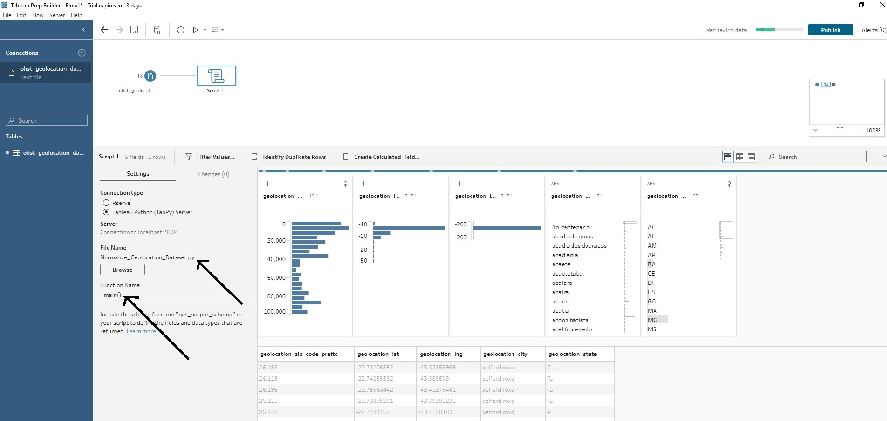
Tabpy in tableau prep builder
TabPy (Tableau Python Server) is an external service that executes Python scripts from within Tableau.
It integrates Python’s libraries (pandas, numpy, scikit-learn, etc.) directly into Tableau workflows

Slide 20
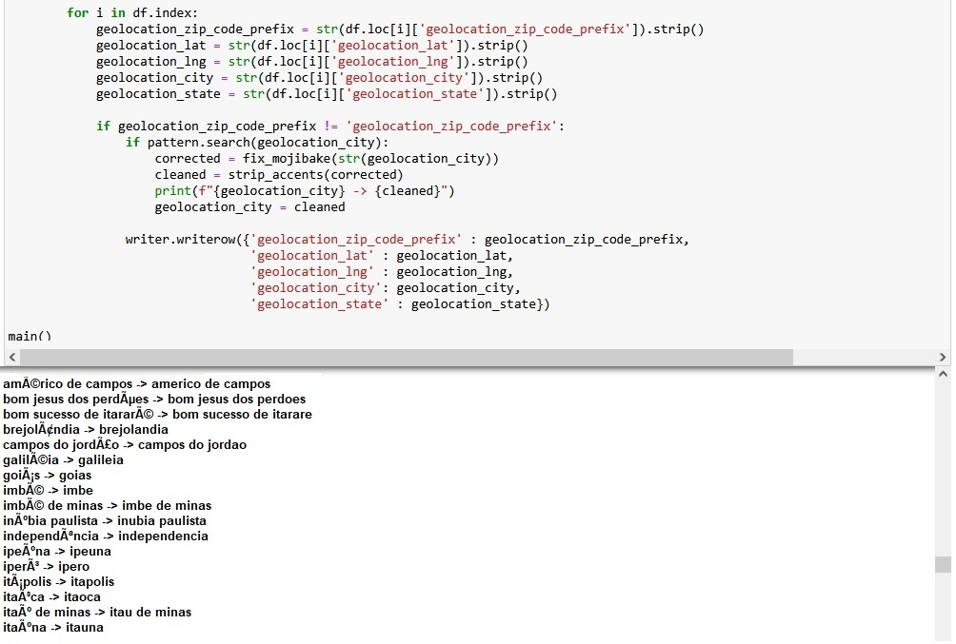
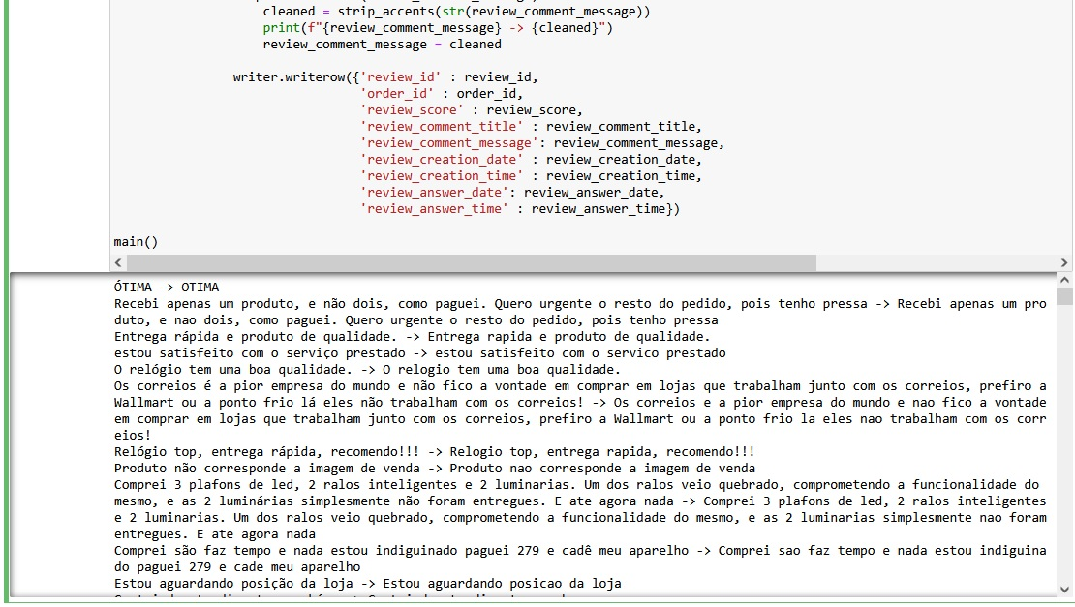
Tabpy in tableau prep builder
In the order_reviews and geolocation tables, there is a mixture of Portuguese words with/without deep accent
Python scripts are integrated into Tableau workflow to convert and standardize (review_comment_message, geolocation_city) fields in order_reviews and geolocation tables :
Transform Portuguese words without accent into Portuguese words with deep accent
Geolocation Table
Order Reviews Table

Slide 21
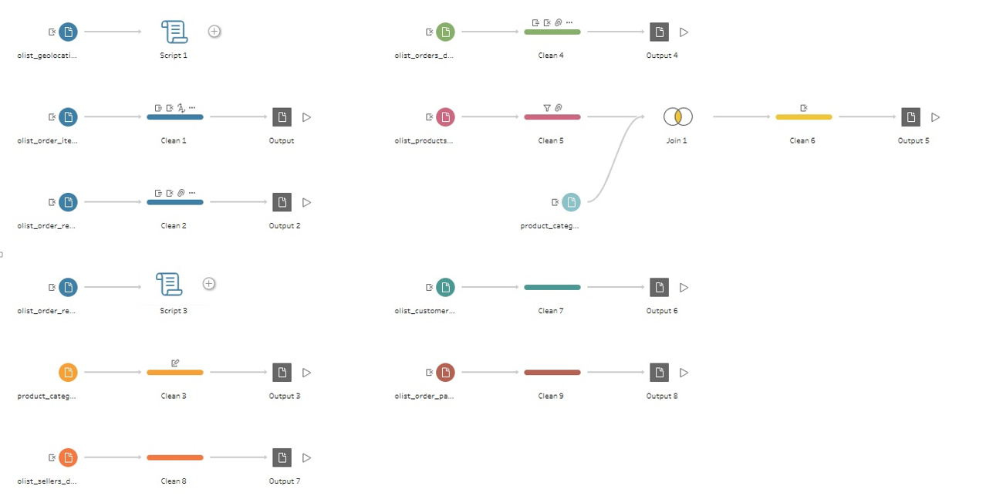
(ET)L using tableau prep builder

Slide 22
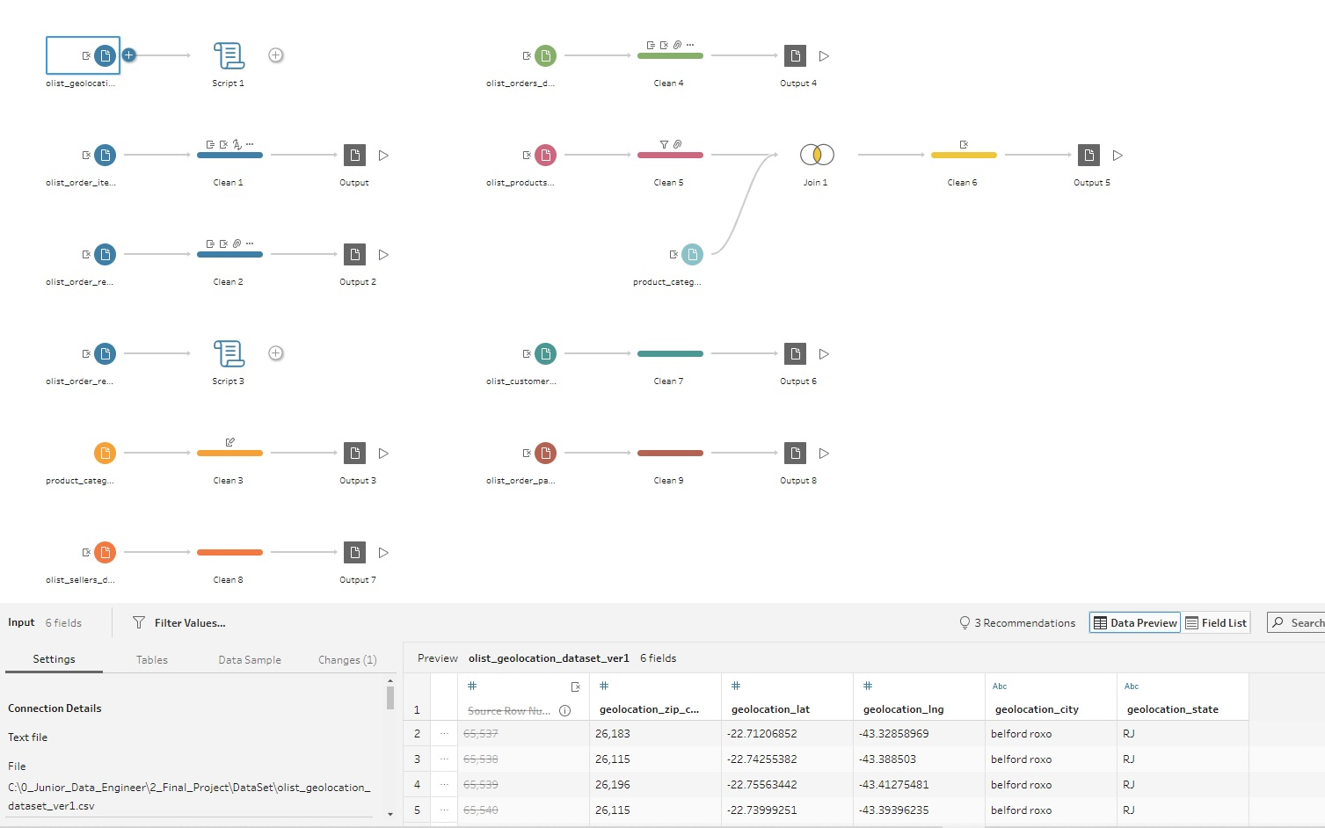
(ET)L using tableau prep builder
Geolocation Dataset -> Transformation Process -> olist_geolocation_dataset_final.csv

Slide 23
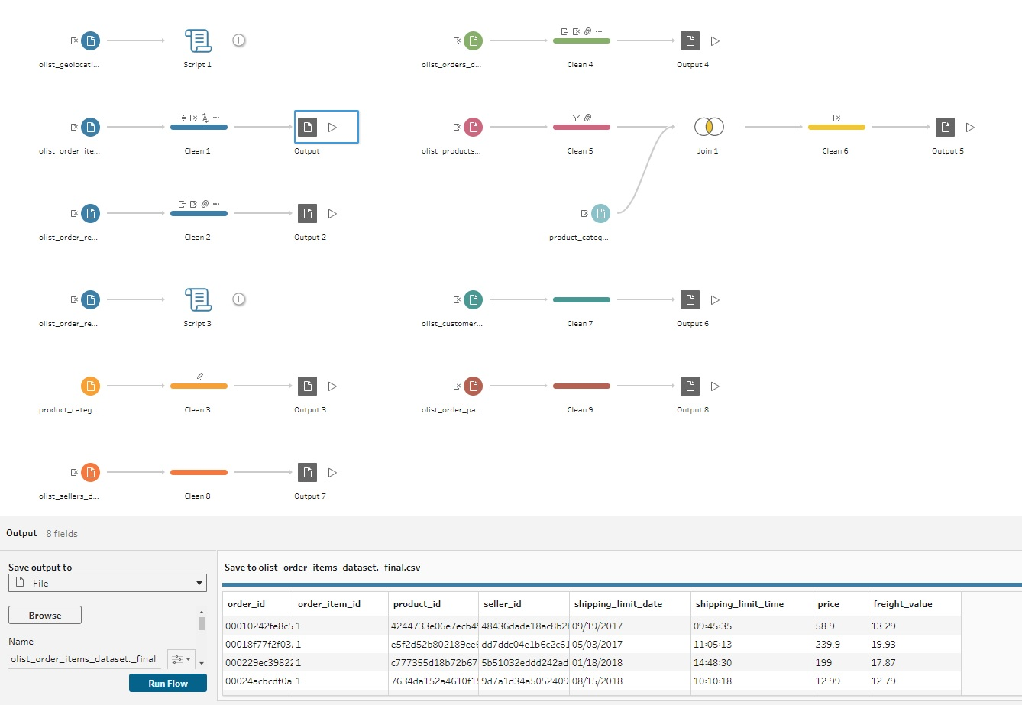
(ET)L using tableau prep builder
Order items Dataset -> Transformation Process -> olist_order_items_dataset_final.csv

Slide 24
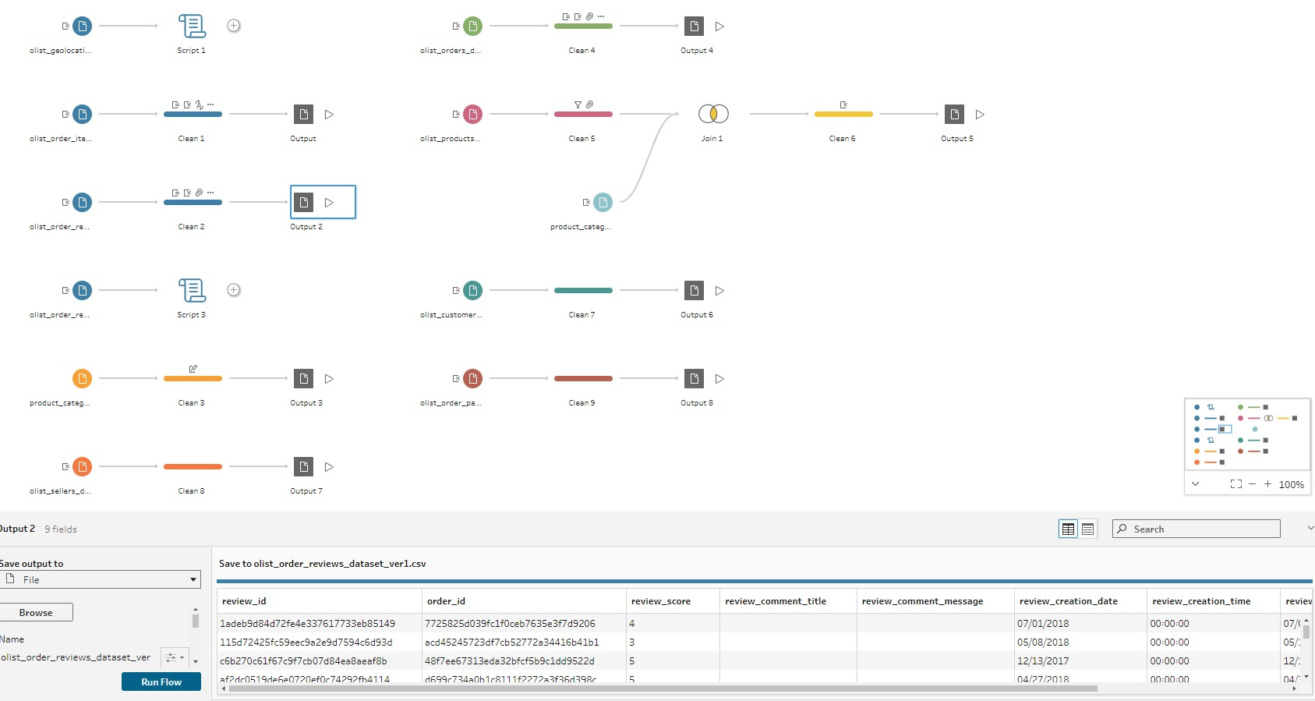
(ET)L using tableau prep builder
Order reviews Dataset -> Transformation Process -> olist_order_reviews_dataset_final.csv

Slide 25
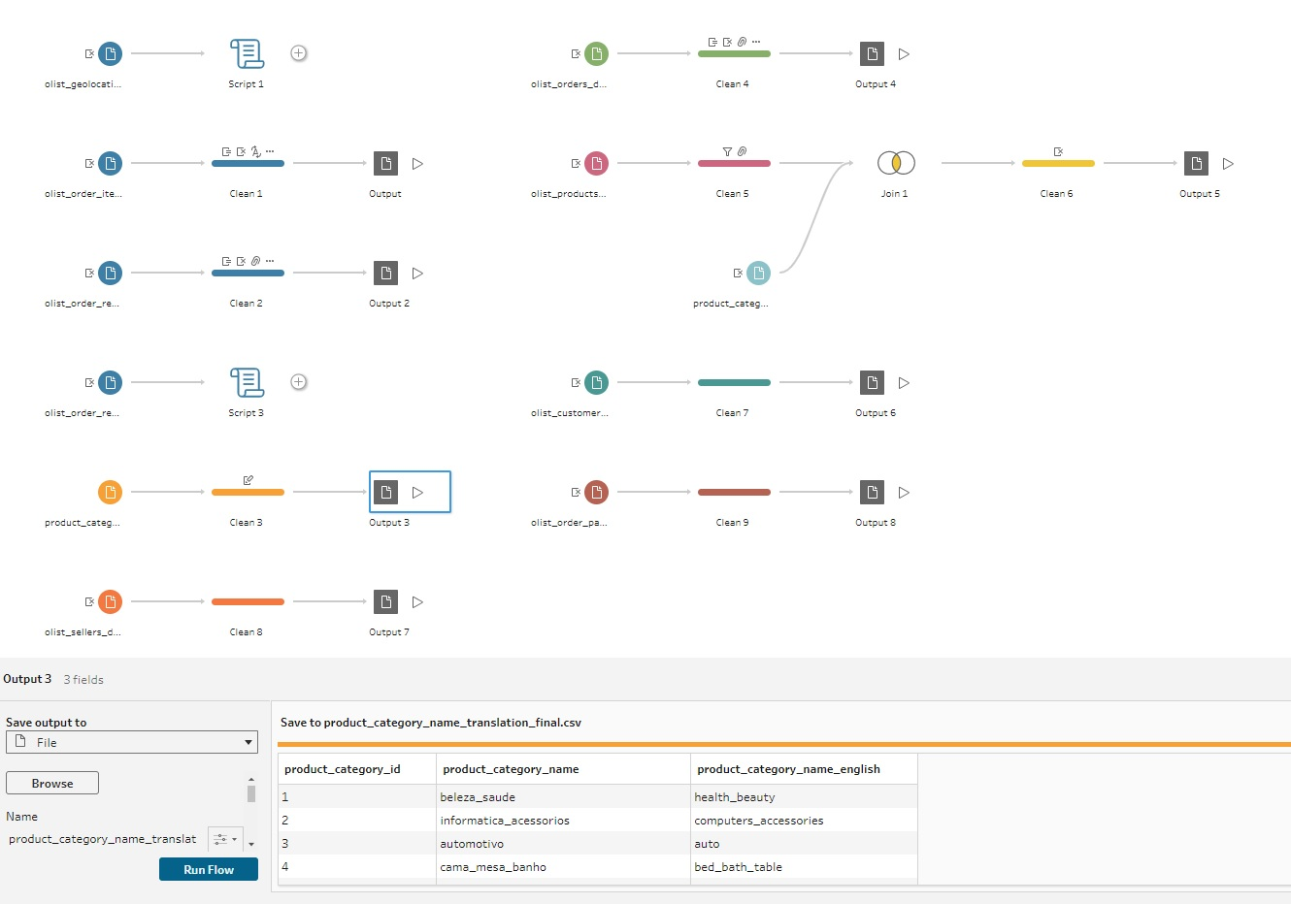
(ET)L using tableau prep builder
Product category name translation Dataset -> Transformation Process -> product_category_name_translation_final.csv

Slide 26
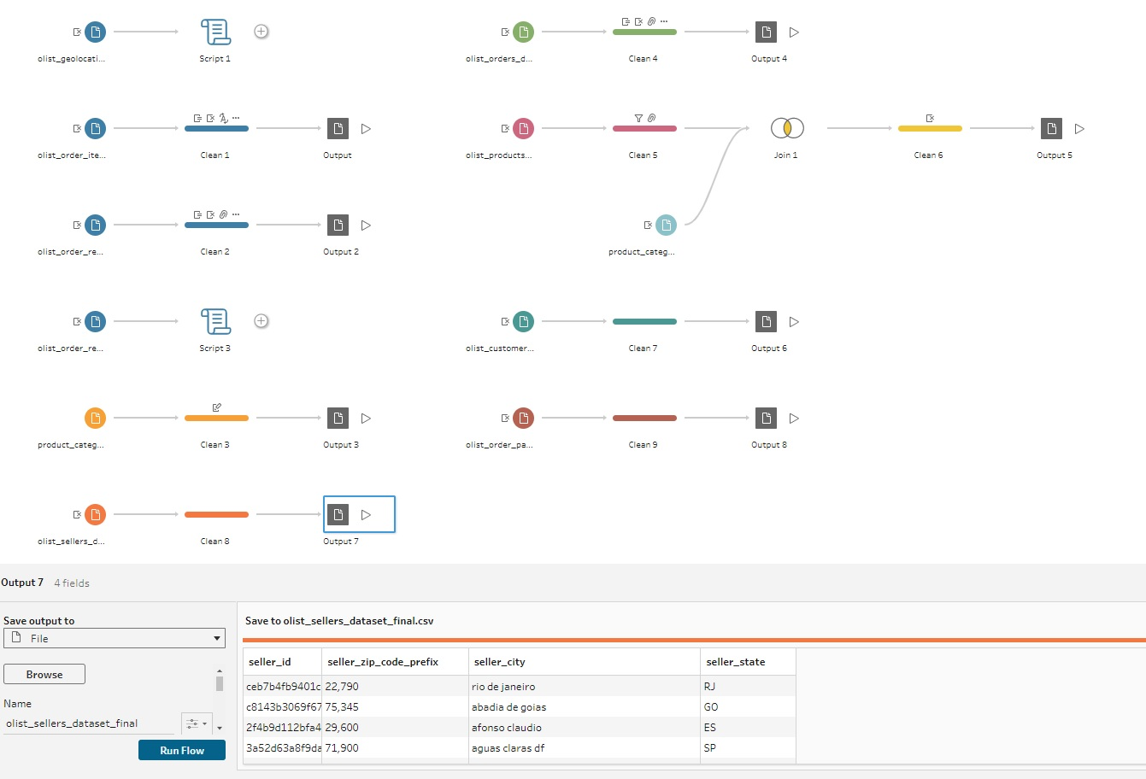
(ET)L using tableau prep builder
Sellers Dataset -> Transformation Process -> olist_sellers_dataset_final.csv

Slide 27
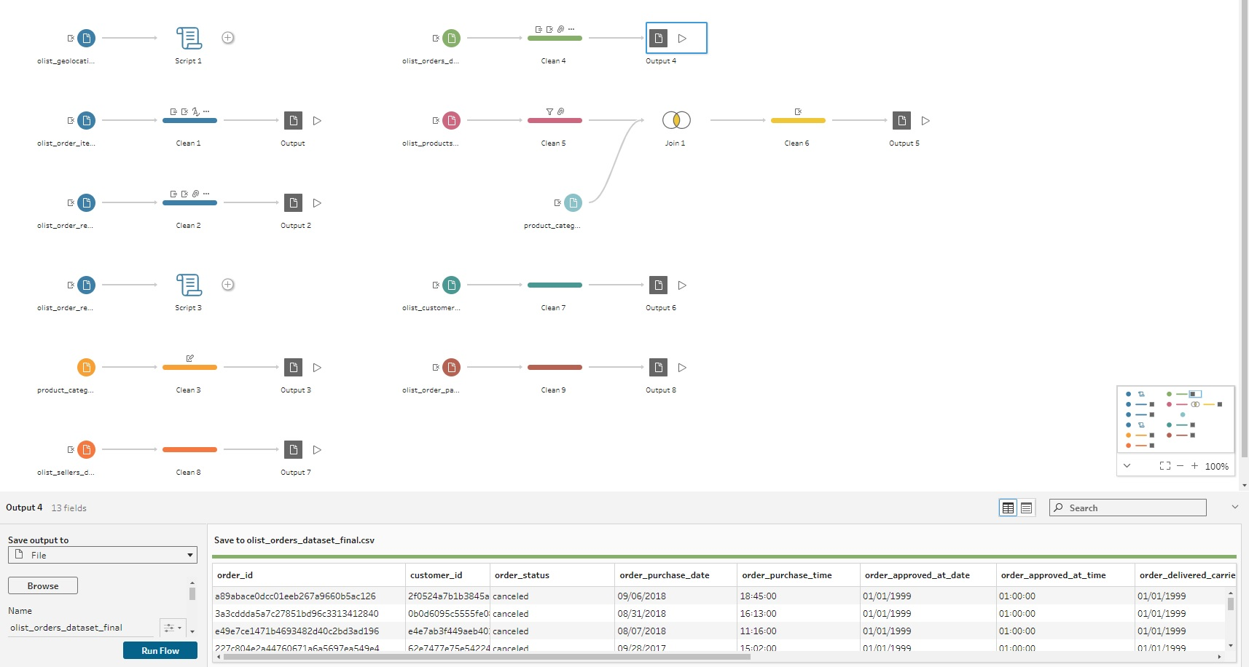
(ET)L using tableau prep builder
Orders Dataset -> Transformation Process -> olist_orders_dataset_final.csv

Slide 28
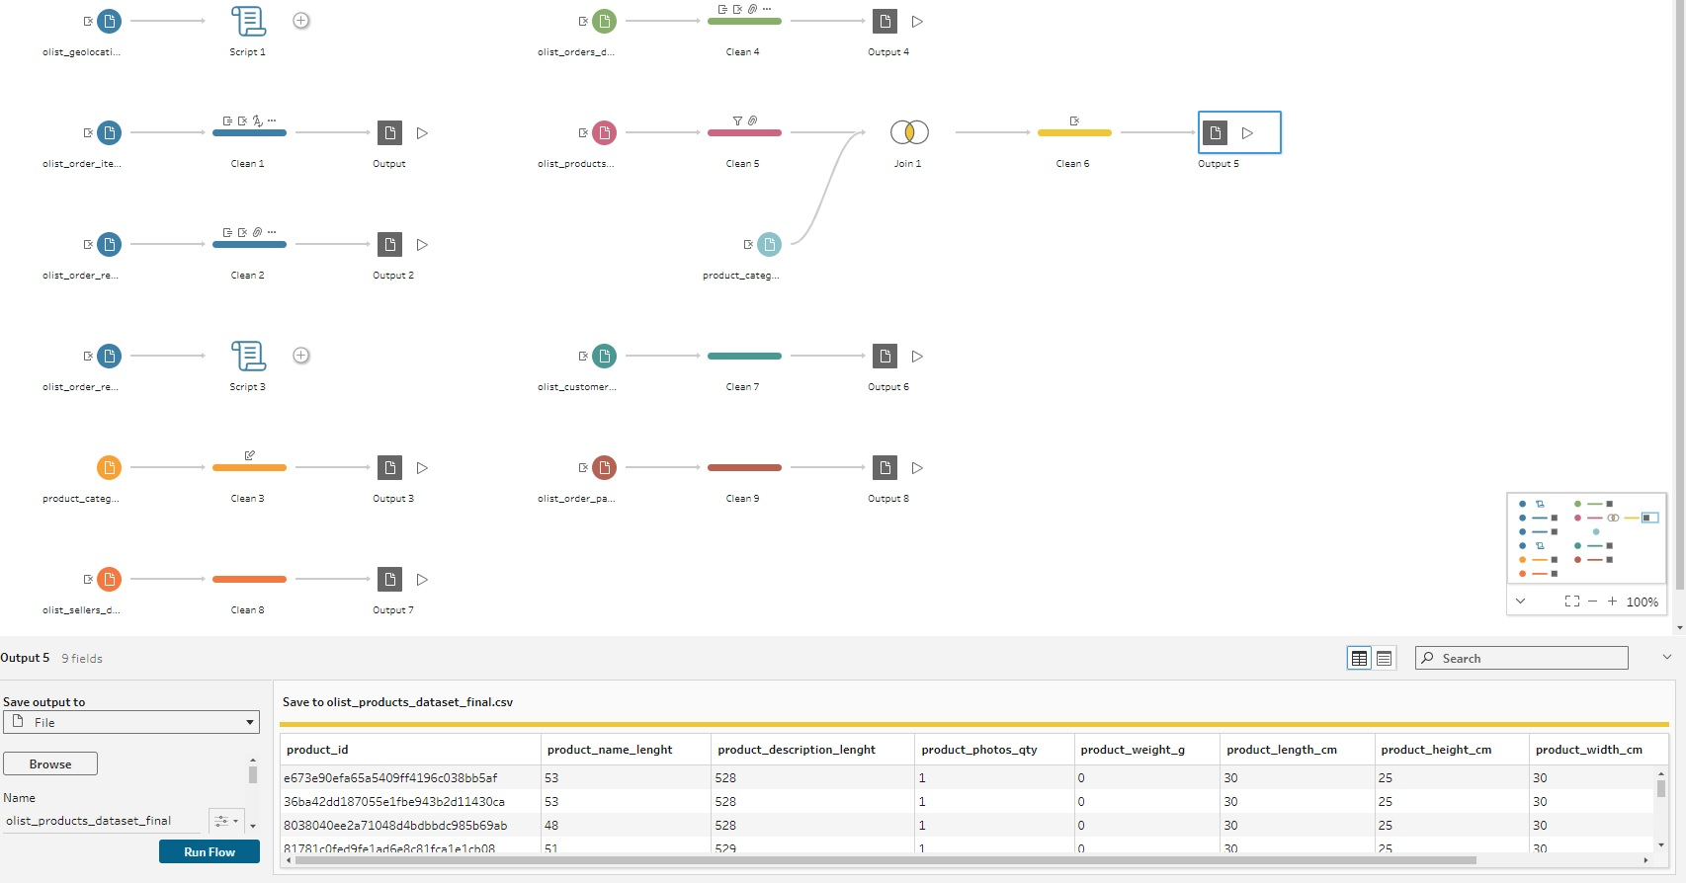
(ET)L using tableau prep builder
Products Dataset -> Transformation Process -> olist_products_dataset_final.csv

Slide 29
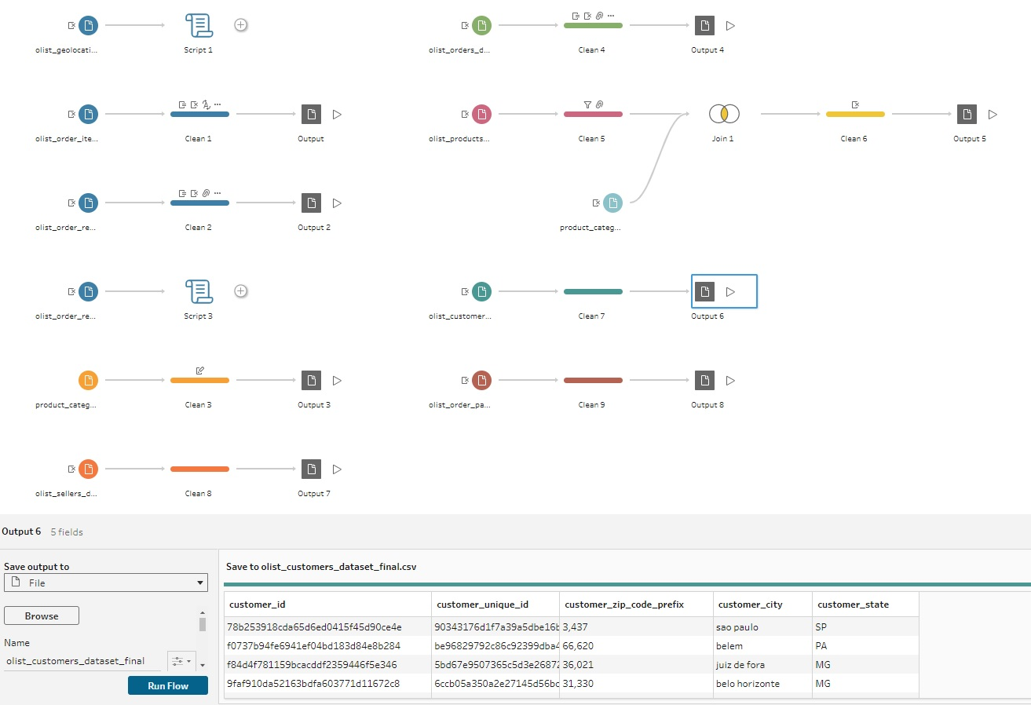
(ET)L using tableau prep builder
Customers Dataset -> Transformation Process -> olist_customers_dataset_final.csv

Slide 30
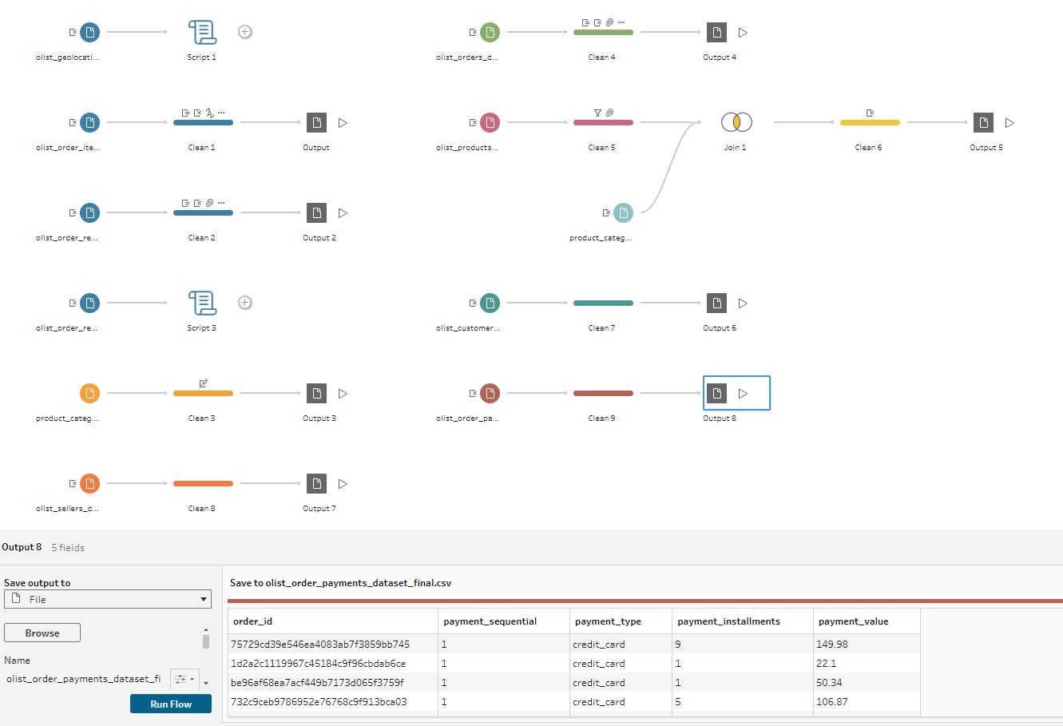
(ET)L using tableau prep builder
Order Payments Dataset -> Transformation Process -> olist_order_payments_dataset_final.csv

Slide 31
(ET)L using tableau prep builder
Transformed and Cleansed Dataset (Final)
Data File | Data description
olist_customers_dataset_final.csv | This dataset has information about the customer and its location. It identifies unique customers in the orders dataset and to find the orders delivery location.
olist_geolocation_dataset_final.csv | This dataset has information Brazilian zip codes and its latitude/longitude coordinates.
olist_order_items_dataset_final.csv | This dataset includes data about the items purchased within each order.
olist_order_payments_dataset_final.csv | This dataset includes data about the orders payment options
olist_order_reviews_dataset_final.csv | This dataset includes data about the reviews made by the customers.
olist_orders_dataset_final.csv | This is the core dataset that contains orders information.
olist_products_dataset_final.csv | This dataset includes data about the products sold by Olist.
olist_sellers_dataset_final.csv | This dataset includes data about the sellers that fulfilled orders made at Olist.
product_category_name_translation_final.csv | This dataset translates the product_category_name to english.

Slide 32
ET(L) Process using pyspark in databricks community on cloud

Slide 33
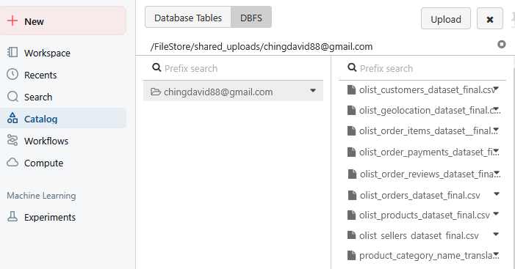
ET(L) Process using pyspark in databricks community on cloud
Upload the 9 final CSV files to Blob Storage in Databricks Community on Cloud

Slide 34
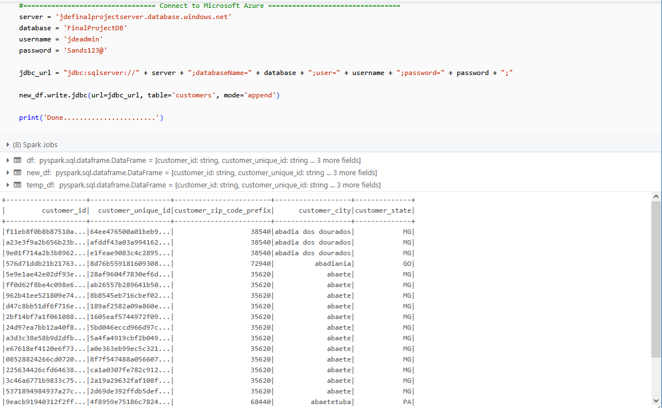
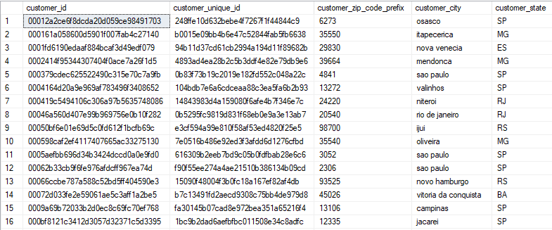
ET(L) Process using pyspark in databricks community on cloud
Run PySpark notebook in Databricks to load olist_customers_dataset_final.csv into Customers Table
Customers Table in Azure MS SQL DB

Slide 35
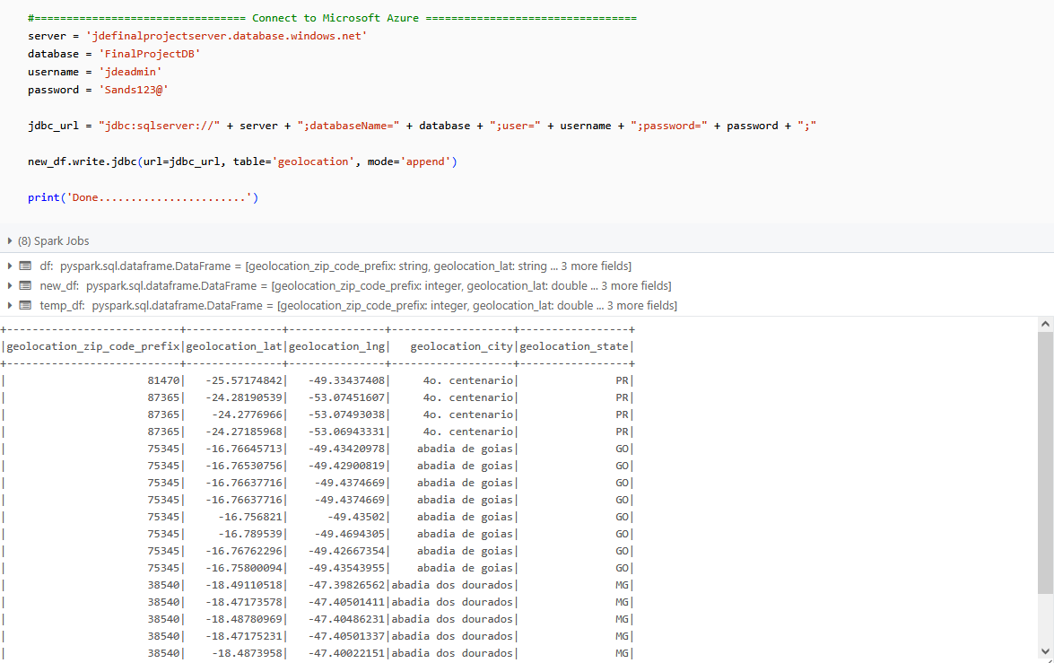
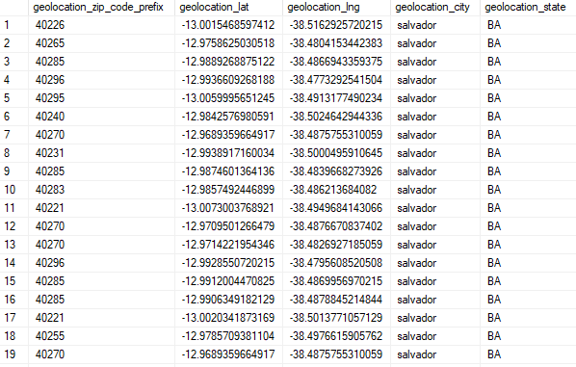
ET(L) Process using pyspark in databricks community on cloud
Run PySpark notebook in Databricks to load olist_geolocation_dataset_final.csv into Geolocation Table
Geolocation Table in Azure MS SQL DB

Slide 36
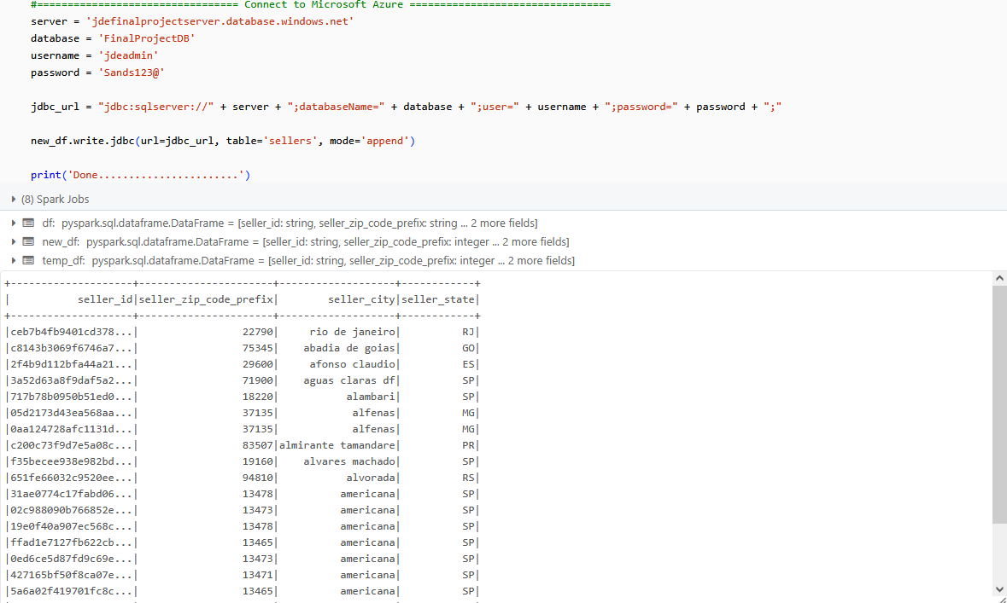
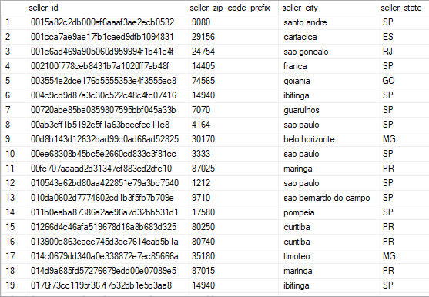
ET(L) Process using pyspark in databricks community on cloud
Run PySpark notebook in Databricks to load olist_sellers_dataset_final.csv into Sellers Table
Sellers Table in Azure MS SQL DB

Slide 37
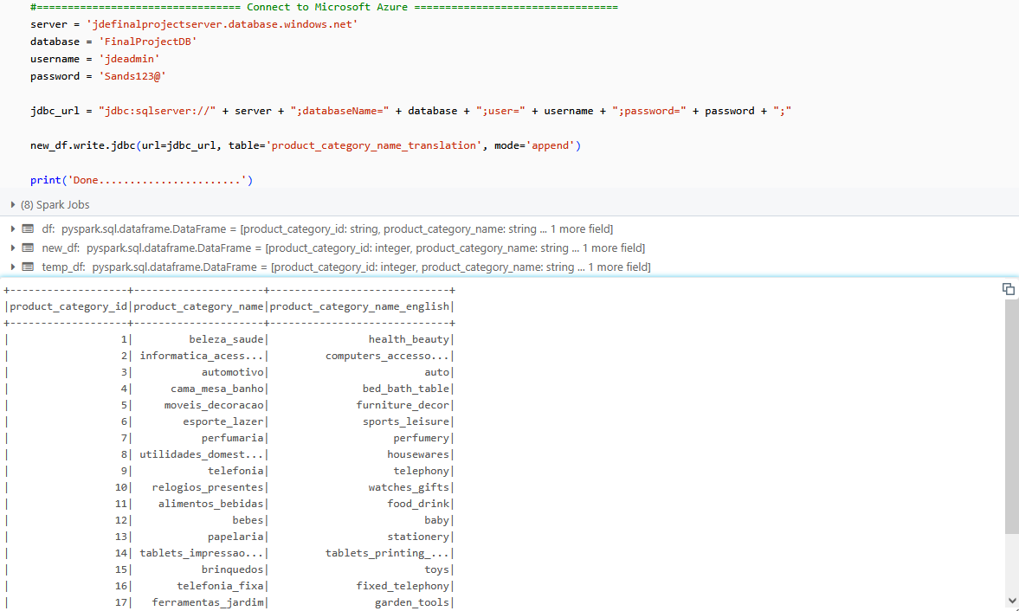
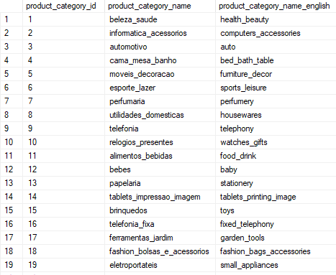
ET(L) Process using pyspark in databricks community on cloud
Run PySpark notebook in Databricks to load product_category_name_translation_final.csv into Product Category Name Translation Table
Product Category Name Translation Table in Azure MS SQL DB

Slide 38
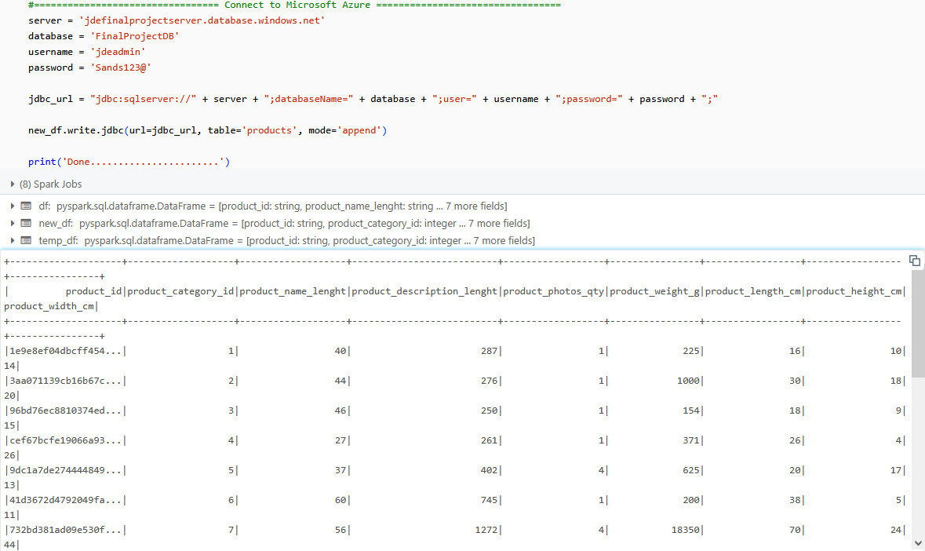
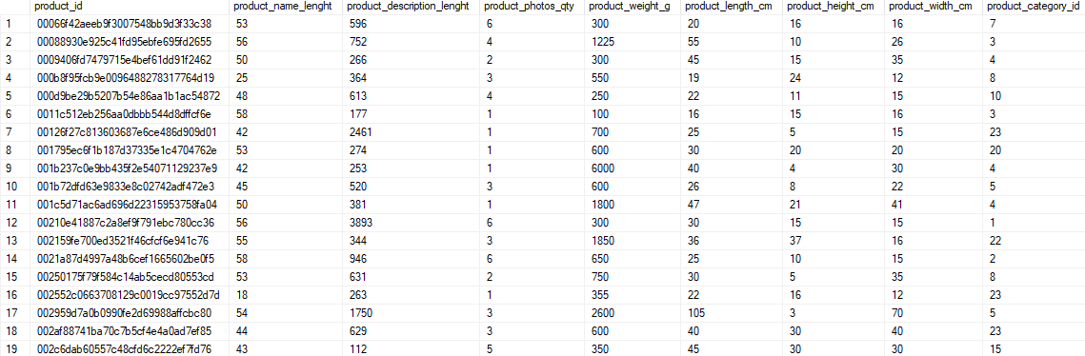
ET(L) Process using pyspark in databricks community on cloud
Run PySpark notebook in Databricks to load olist_products_dataset_final.csv into Products Table
Products Table in Azure MS SQL DB

Slide 39
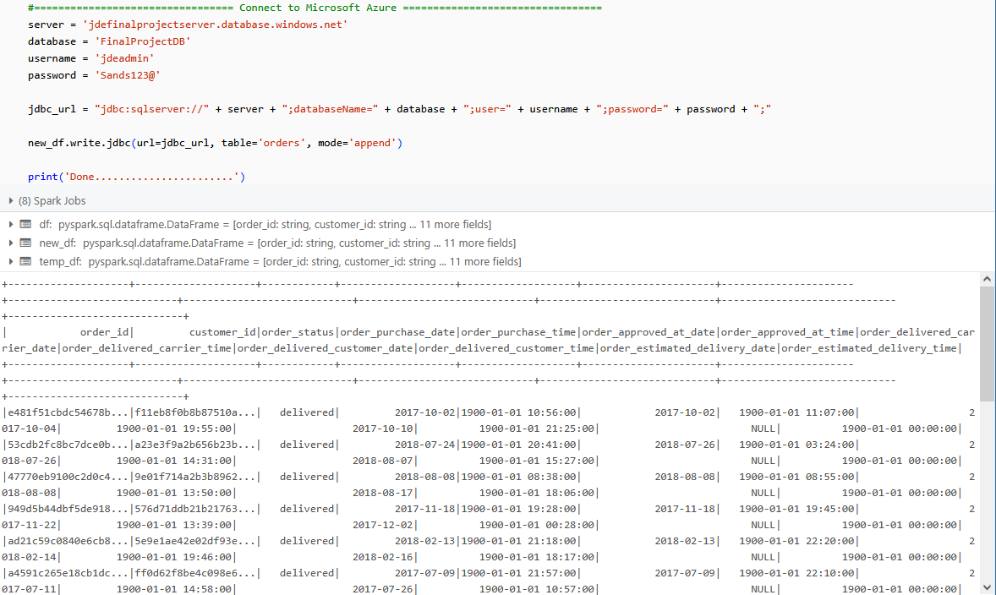
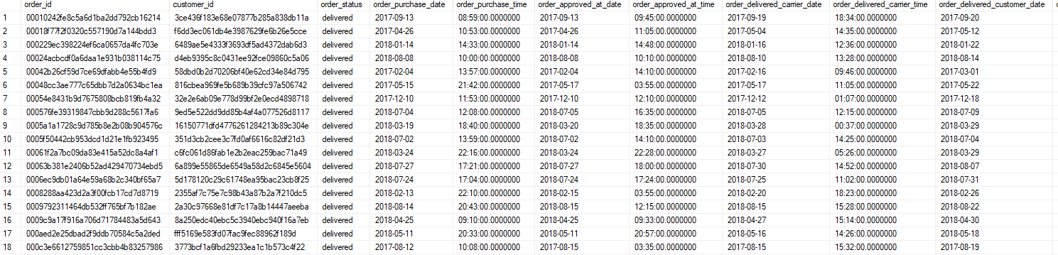
ET(L) Process using pyspark in databricks community on cloud
Run PySpark notebook in Databricks to load olist_orders_dataset_final.csv into Orders Table
Orders Table in Azure MS SQL DB

Slide 40
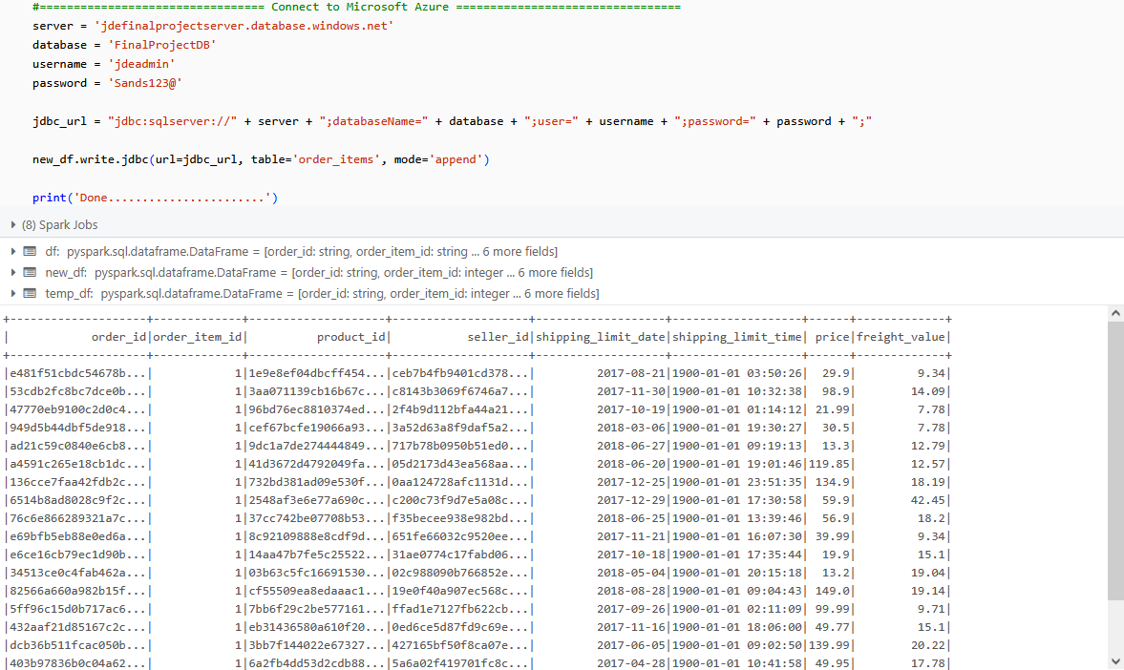
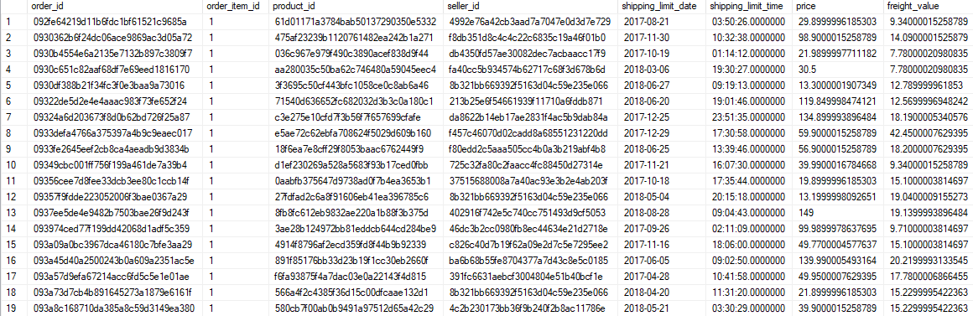
ET(L) Process using pyspark in databricks community on cloud
Run PySpark notebook in Databricks to load olist_order_items_dataset_final.csv into Order Items Table
Order Items Table in Azure MS SQL DB

Slide 41
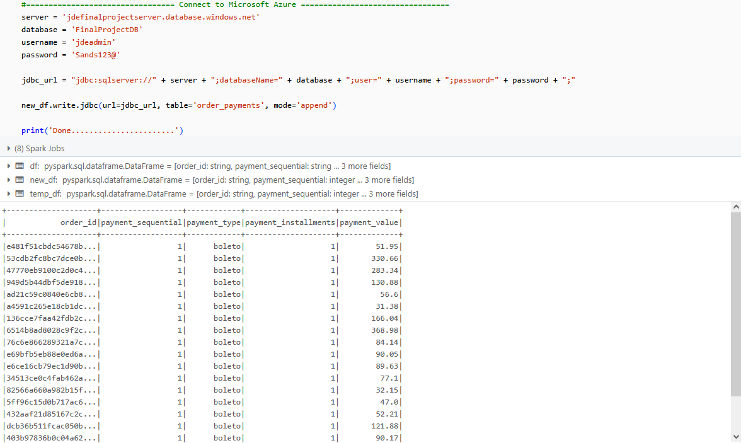
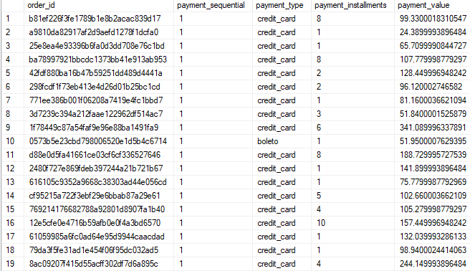
ET(L) Process using pyspark in databricks community on cloud
Run PySpark notebook in Databricks to load olist_order_payments_dataset_final.csv into Order Payments Table
Order Payments Table in Azure MS SQL DB

Slide 42
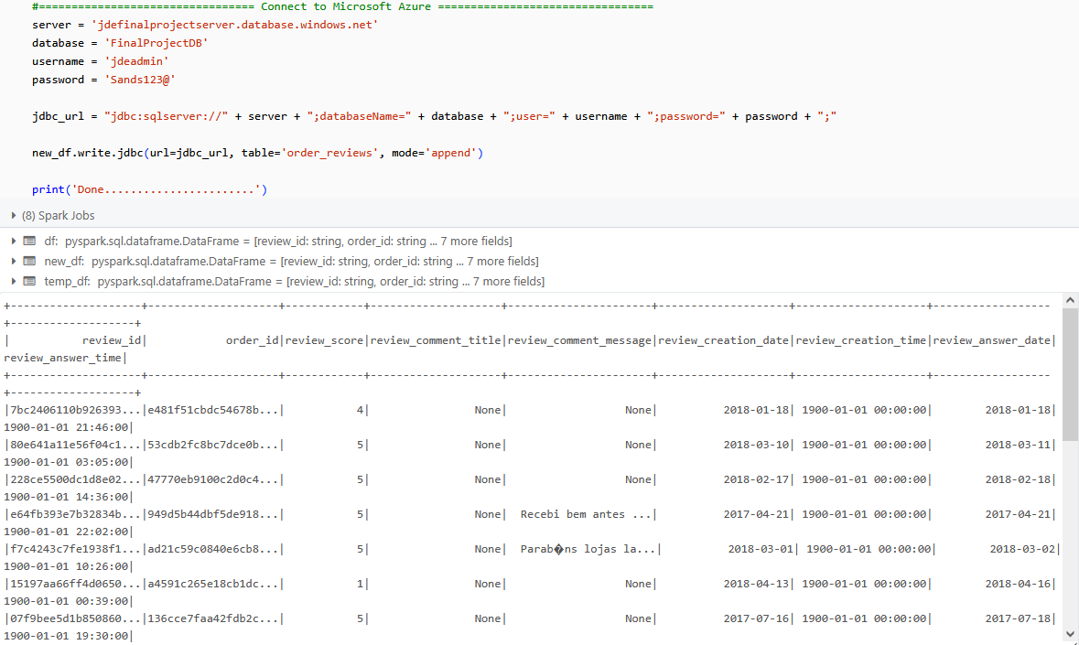
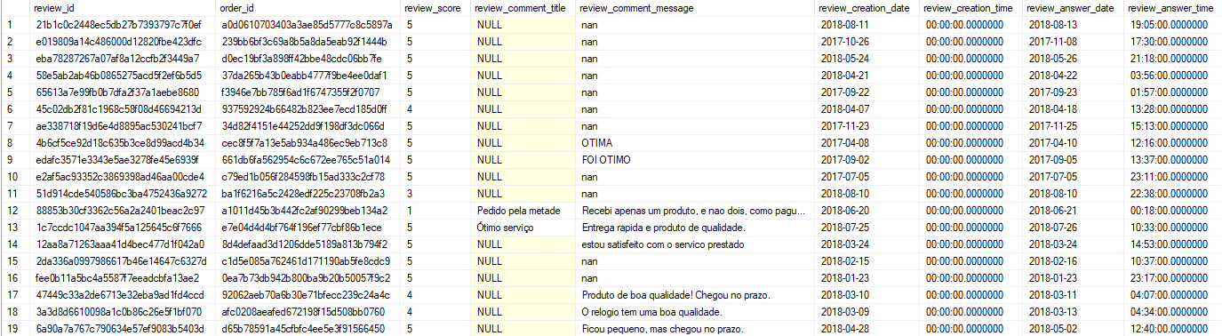
ET(L) Process using pyspark in databricks community on cloud
Run PySpark notebook in Databricks to load olist_order_reviews_dataset_final.csv into Order Reviews Table
Order Reviews Table in Azure MS SQL DB

Slide 43
workflows in databricks community on cloud

Slide 44
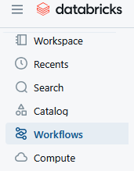
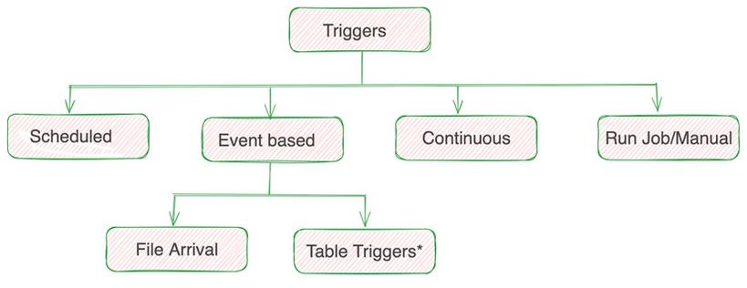
Workflows in databricks community on cloud
Databricks Workflows service enables process of creating, managing, and monitoring data pipelines and workflows
Databricks Workflows can be triggered by :
Scheduled trigger : Task and set a schedule to run entire Jupyter Notebook in the UI that follows Quartz CRON syntax.
Event trigger : Job execution based on specific occurrences or conditions, enhancing automation and eliminates external services (AWS Lambda/Azure Functions, etc.) to trigger Databricks jobs.
Continuous trigger : Runs real-time streaming jobs efficiently and new job run will automatically start if the existing run fails.
Run Job/Manual : The run job triggers an existing job via the UI to manually trigger a job.

Slide 45
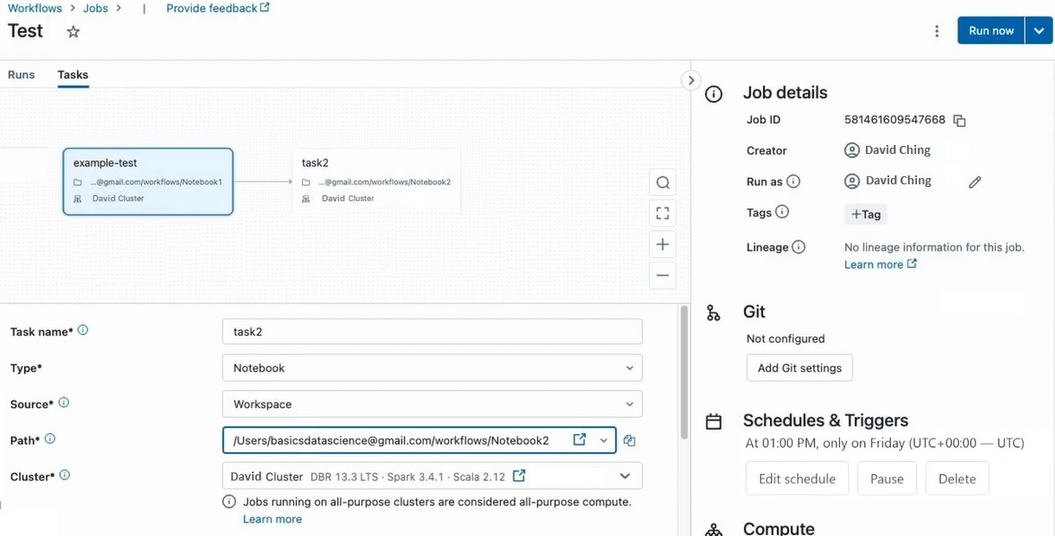
Workflows in databricks community on cloud

Slide 46
Data verification of data loaded into azure sql db and queried by power bi

Slide 47
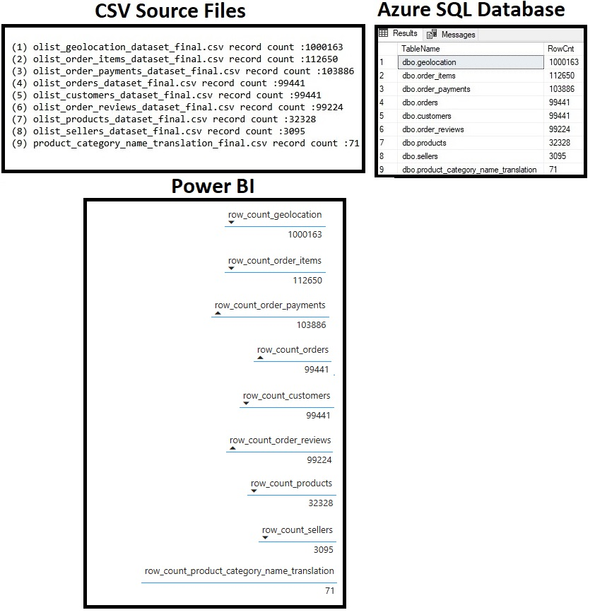
Row count tally for source files and all tables from Azure SQL DB and power bi

Slide 48
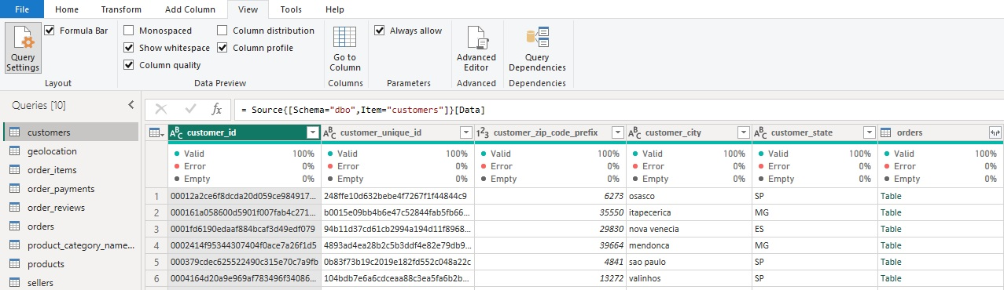
Column quality verification using power bi
Customers Table

Slide 49
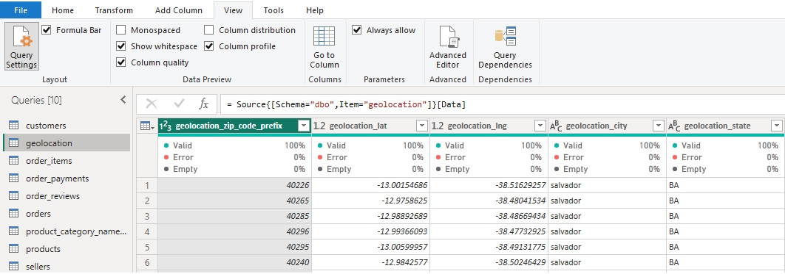
Column quality verification using power bi
Geolocation Table

Slide 50
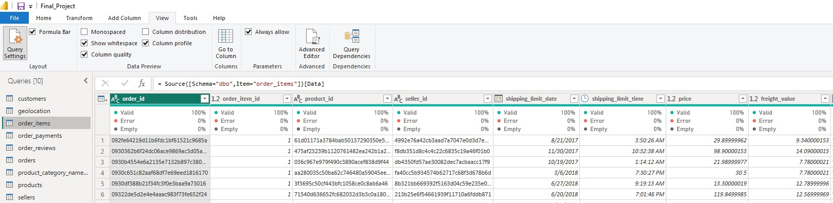
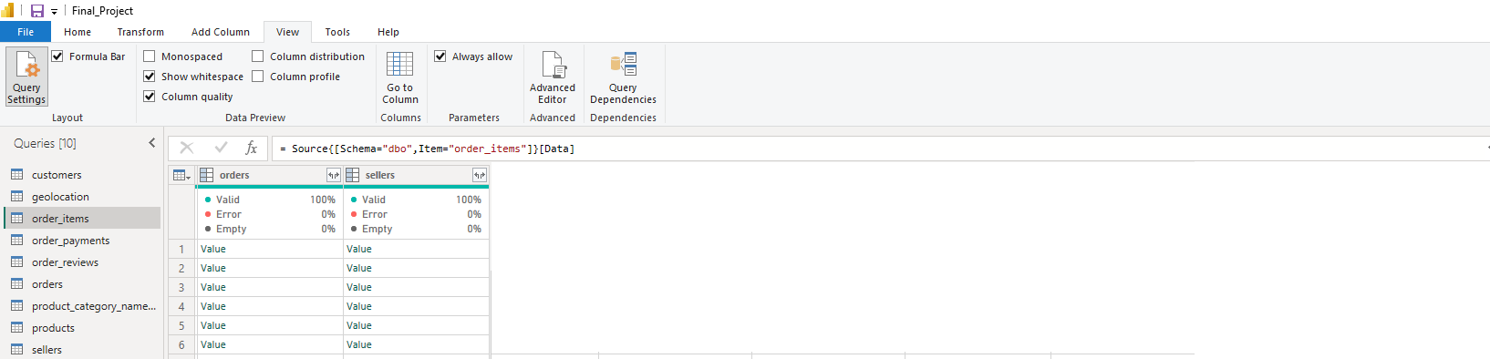
Column quality verification using power bi
Order Items Table

Slide 51
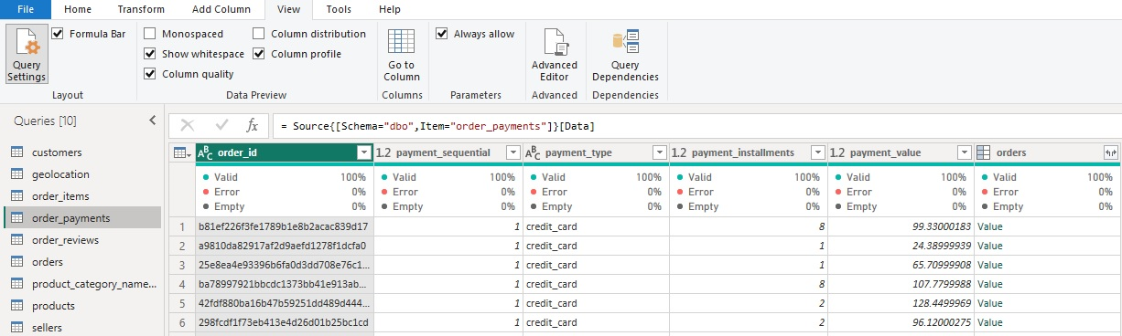
Column quality verification using power bi
Order Payments Table

Slide 52
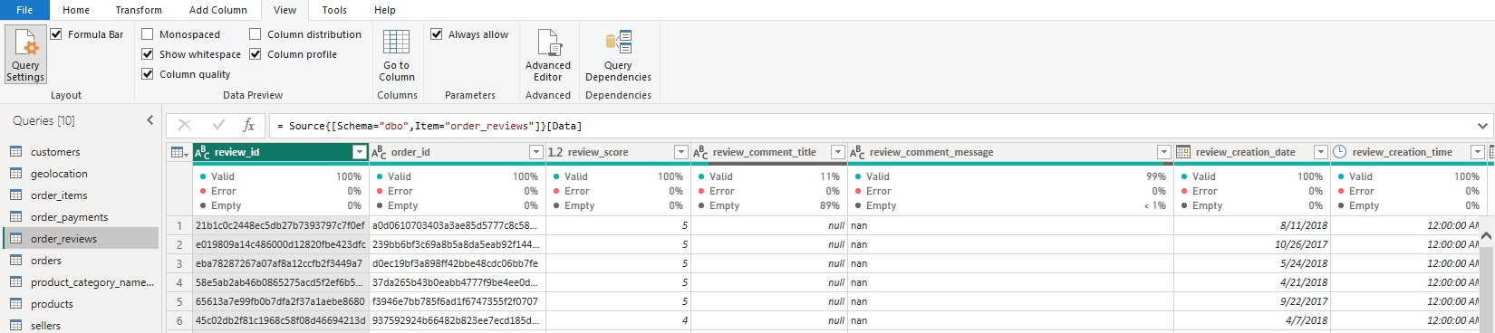
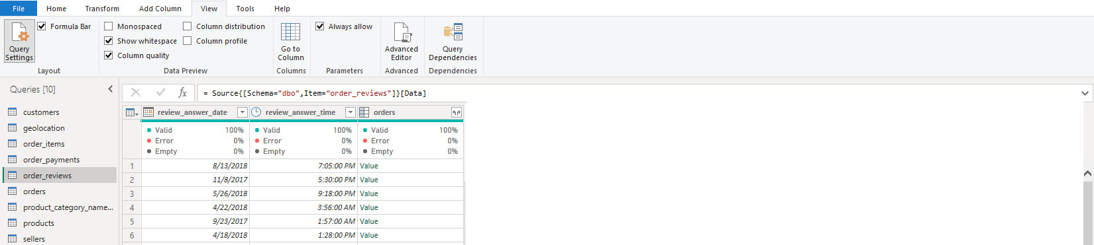
Column quality verification using power bi
Order Reviews Table

Slide 53
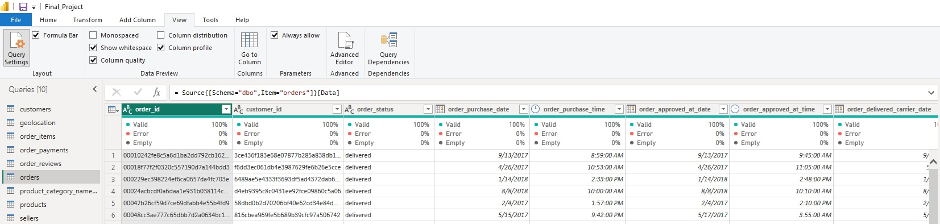

Column quality verification using power bi
Orders Table

Slide 54

Column quality verification using power bi
Product Category Name Translation Table

Slide 55


Column quality verification using power bi
Products Table

Slide 56

Column quality verification using power bi
Sellers Table

Slide 57
Artificial intelligence using mllib (machine learning library) in databricks community on cloud

Slide 58
Pyspark Machine Learning Library (mllib) in databricks
PySpark MLlib is Apache Spark’s scalable machine learning library.
PySpark MLlib provides tools for building and deploying machine learning models on large datasets in a distributed computing environment.
MLlib is part of Spark's pyspark.ml package (DataFrame-based API)
Key Features:
a) Algorithms: Includes classification, regression, clustering, and collaborative filtering.
b) Pipelines: Supports building ML workflows using Pipeline and PipelineModel for reproducibility
c) Data Handling: Works seamlessly with Spark DataFrames, enabling easy integration with large-scale data.
d) Feature Engineering: Offers tools like transformers and feature selectors.
e) Distributed Processing: Utilizes Spark’s parallel processing for faster computation on big data.

Slide 59


supervised learning – linear regression model
Predict Payment Type Field (boleto, credit card, debit card, voucher, not defined) based on (Payment_Sequential, Payment_Installments, Payment_Value) Fields in Order Payments Table

Slide 60


supervised learning – decision tree model
Predict Payment Type Field (boleto, credit card, debit card, voucher, not defined) based on (Payment Sequential, Payment Installments, Payment Value) Fields in Order Payments Table

Slide 61


Deep learning – recurrent neural network (rnn) model
Predict Payment Type Field (boleto, credit card, debit card, voucher, not defined) based on (Payment Sequential, Payment Installments, Payment Value) Fields in Order Payments Table

Slide 62


unsupervised learning – k means clustering model
Elicit Clusters for Payment Type Field on Order Payments Table

Slide 63
Business intelligence using power bi

Slide 64

Dashboard 1 (Review scores)

Slide 65

Dashboard 2 (review scores vs product category names)

Slide 66

Dashboard 3 (review scores by geolocation distribution)

Slide 67
Analyzed Result
The word cloud analysis of customer reviews highlights the key themes related to the product delivery, timing, and quality.
The most frequently used words (translated from Portuguese) include:
(1) produto → product
(2) entregue → delivered
(3) chegou → arrived
(4) prazo → deadline / delivery time
(5) recebi → received
(6) nao → not
(7) bom → good
(8) antes → before / earlier
(9) compra → purchase
(10) qualidade → quality
This indicates that many reviews focus on
(1) delivery timing issues ("prazo", "chegou antes")
(2) product reception ("recebi", "entregue")
(3) quality feedback ("bom", "qualidade")
Negative sentiment is also visible through words like
(1) ainda nao ("still not received")
The analysis of review comments reveals that negative reviews (1-2 stars) are more likely to contain more written feedback,
while higher ratings (4-5 stars) often lack text comments.
This suggests that dissatisfied customers tend to provide detailed feedback, whereas satisfied customers typically leave only a rating.
These insights highlight areas for improvement, particularly in delivery reliability and customer satisfaction.

Slide 68
Analyzed Result
For product category review score distribution coverage :
(1) Bed Bath Table category products have the largest review score distribution coverage
(2) Home Confort (Home Comfort) category products have the smallest review score distribution coverage
For geolocation review score distribution coverage :
(1) Brazil state (Sao Paulo) has the largest review score distribution coverage (173,952)
(2) Brazil state (Acre) has the smallest review distribution score coverage (486)

Slide 69

Conclusion

Slide 70
Conclusion
The final project showcases a robust end-to-end data analytics pipeline that seamlessly integrates data engineering, artificial intelligence, and business intelligence tools to deliver actionable insights on Brazil Olist ecommerce data.
Data Preparation and Transformation with Tableau Prep Builder The journey begins with Tableau Prep Builder, where raw CSV data is meticulously extracted, cleaned, and transformed using intuitive workflows. The processed data is then saved as final CSV files, ensuring consistency and readiness for advanced processing.
Scalable Data Ingestion with PySpark on Databricks Community Edition Leveraging the power of PySpark in the Databricks Community on Cloud environment, the final CSV files are efficiently loaded into an Azure SQL Database. This cloud-based architecture ensures scalability, reliability, and fast data handling, laying a solid foundation for downstream analytics.
AI-Driven Insights with PySpark Mllib on Databricks Community Edition The project harnesses PySpark’s MLlib to perform sophisticated machine learning and artificial intelligence analysis. From predictive modeling to pattern recognition, MLlib enables and uncovers deep insights and generate data-driven forecasts with precision.
Business Intelligence Visualizations with Power BI Power BI is used to transform complex analytical results into intuitive and interactive dashboards. Business users can explore trends, monitor KPIs, and make informed decisions in real time through visually engaging dashboards.

Slide 71
The End

